Slide 1
GAR
Session 08: Angry Birds
Notes:
Welcome. Today we build Angry Birds. The main topic: a library behind your own interface.
Start by playing the finished game, Birds4, before any code.

Slide 2
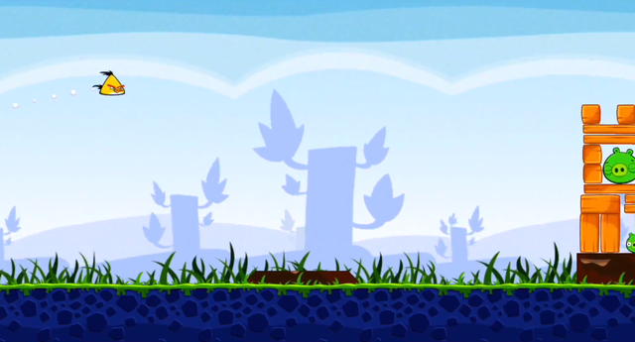
Angry Birds
Angry Birds (Rovio, 2009). Image: Sony Pictures, CC BY 3.0, via Wikimedia Commons.
Notes:
The original: Angry Birds. Ask who has played it, and what they remember of how it plays.
Today we build the parts that matter for the architecture, not the whole game.

Slide 3
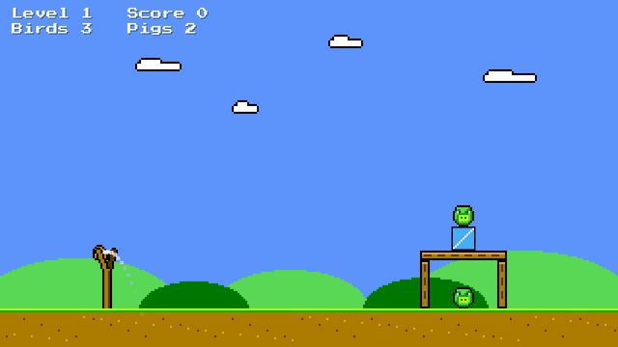
Today’s Goal
Notes:
Run Birds4 and play it for a minute.
Ask: what would you need to build this? Collect answers on the board, and come back to them at the end.

Slide 4
Today’s Topics
Main topic: A library behind your own interface
A Physics Library
Adapter & Facade
Two Worlds: Metres and Pixels
Contact Events
Destroying Safely
Prototype
Notes:
The main topic: a library behind your own interface, so it doesn’t spread through your code. Adapter and Facade, two worlds, contact events, and Prototype.

Slide 5
Source Code
github.com/Metamate/gar-games, folder 08-angry-birds
Its README: the steps (Birds0 to Birds4), where things are in the code, how to run it
The course site: today’s concepts in full, the exercises, and questions to check yourself
Notes:
Open gar-games/08-angry-birds live. Show the README: the step table, the code map, how to run a step.
Say: the site explains the ideas, the README helps you find them in the code, the slides are for today.

Slide 6
A Physics Library
Stacks that tip, bounce and break: we use Box2D, not our own physics.
A world of bodies
static: never move (the ground)
dynamic: gravity and collisions
Bodies have shapes
boxes, circles, polygons
with friction and density
Step the world
Read the positions
Draw the sprites there
Notes:
Tipping, bouncing stacks are far beyond Mario’s physics. Box2D does it for us.
The loop: step the world, read where the bodies are, draw the sprites there.

Slide 7
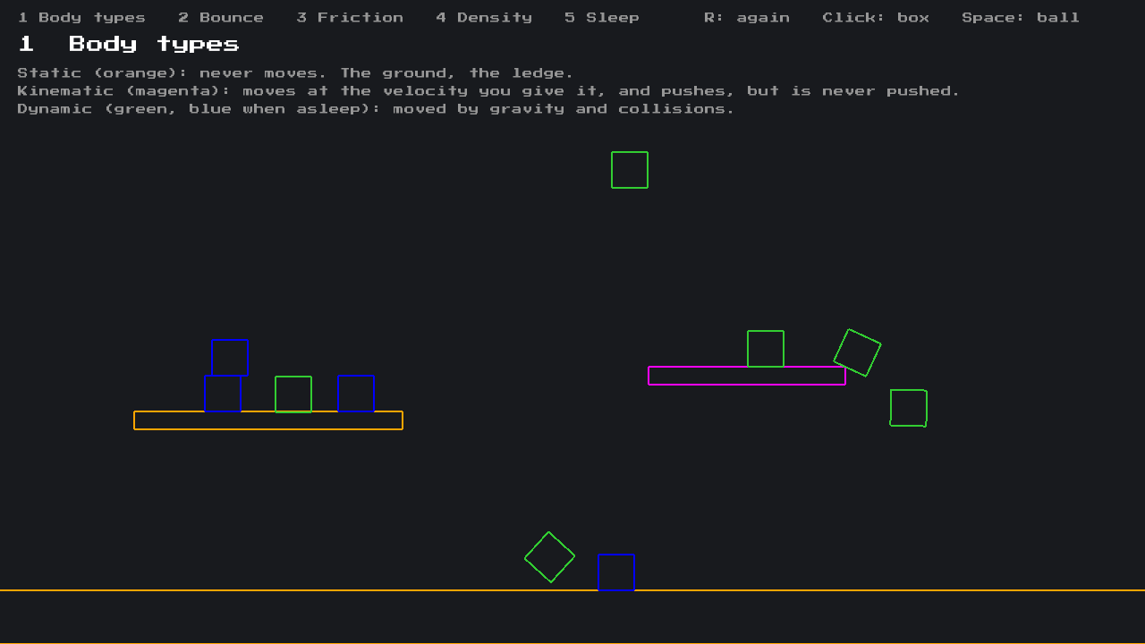
Physics Samples
Next to the steps: PhysicsSamples, one idea per scene
Body types, bounce, friction, density, sleeping, joints
Keys 1 to 6; click: a box, Space: a ball, R: again
Notes:
Demo: run PhysicsSamples and go through the scenes.
1: static (orange), kinematic (magenta: moves at its own velocity, pushes, is never pushed), dynamic (green, blue when asleep).
2: restitution, how much speed a bounce keeps. 3: friction, the same slope. 4: density, the same ball fifty times heavier.
5: sleeping, the pile turns blue; drop a box in to wake it. 6: joints: a hinged pendulum and chain, a rope that goes slack, a welded hammer.
Mention: the samples use the game’s facade, which got BodyType and joint methods so they could make a kinematic platform and joints.

Slide 8
Try It: Physics Samples
In PhysicsSamples:
Make the platform move up and down instead of sideways
Find the lowest friction at which the box stays on the slope
Is it what you expected for 26 degrees? Then: hang the ball from the chain
Notes:
Pairs, about 7 minutes. The platform: its velocity and the two turning points in BodyTypesScene.
The friction: about 0.23, not tan 26° (about 0.48). Box2D combines two frictions as the square root of their product, and the slope’s friction is 1: the square root of 0.23 is 0.48. A good reason to read what a library does.
The chain: Rope(lastLink, ball, ...) instead of Rope(hook, ball, ...), keeping the last link in a variable.

Slide 9
Box2D, Used Directly
A foreign API
  C-style functions, structs passed with in, IDs instead of objects
Another world’s units
  Metres, and y pointing up
  Divide, multiply and flip y everywhere
All through Game1
B2BodyDef bodyDef = b2DefaultBodyDef();
bodyDef.type = B2BodyType.b2_dynamicBody;
bodyDef.position = new B2Vec2(
x / PixelsPerMeter, -y / PixelsPerMeter);
B2BodyId body = b2CreateBody(_world, in bodyDef);
B2Polygon box = b2MakeBox(
width / 2 / PixelsPerMeter,
height / 2 / PixelsPerMeter);
B2ShapeDef shapeDef = b2DefaultShapeDef();
shapeDef.material.friction = 0.6f;
b2CreatePolygonShape(body, in shapeDef, in box);
// And every frame, for every body:
B2Vec2 p = b2Body_GetPosition(body);
Vector2 pixels = new(p.X * PixelsPerMeter,
-p.Y * PixelsPerMeter);
Notes:
Birds0 calls Box2D from Game1. Point at the conversions: divide, multiply, flip y, everywhere.
Ask: what happens when we add a second kind of block? The same lines again.

Slide 10
Why Metres?
A 50-pixel block, taken as metres, is a 50-metre building: it falls in slow motion.
Our game
pixels, y down,
clockwise
÷ 50, flip y
Box2D
metres, y up,
counter-clockwise
× 50, flip y
Forget one conversion. What do you see?
Notes:
Box2D is tuned for things 0.1 to 10 metres big. Treat 50 pixels as 50 metres and a block falls like a building.
Ask the question: forget one conversion; what do you see? A body in the wrong place, spinning the wrong way, or falling up.

Slide 11
Box2D Implementation
DEMO!
Birds0: Box2D, used directly in Game1
Notes:
Demo: run Birds0.
- Game1 full of Box2D calls and unit conversions
- launch a bird: the physics itself works

Slide 12
Try It: A Different Scale
In Birds0:
Change PixelsPerMeter from 50 to 10
How many lines does it touch? How do the blocks fall now?
Notes:
Pairs, about 5 minutes. The constant is used all through Game1. At 10, a block is five times bigger in metres, so it falls like a building: slowly.

Slide 13
Adapter & Facade
Keep Box2D in one place: the rest of the game never sees a Box2D type.
The game: blocks, pigs, birds, levels
PhysicsWorld: a Facade
a handful of calls: create, step, destroy
PhysicsBody: an Adapter
a body in pixels, turning like SpriteBatch
Box2D: hundreds of functions, metres, structs and IDs
Swap Box2D for another library. Which files change?
Notes:
The layers: the game at the top, Box2D at the bottom, and our two classes between.
Facade: a small interface in front of a big subsystem. Adapter: converts one interface into the one we expect.
Ask the question: swap the library, which files change? Only the Physics folder.

Slide 14
The Adapter: PhysicsBody
Wraps a B2BodyId
Position in pixels
Rotation that turns like SpriteBatch
Owner: the entity it belongs to
Units: every conversion, in one place
public sealed class PhysicsBody
{
internal B2BodyId Id { get; }
public object Owner { get; }
public Vector2 Position =>
Units.ToPixels(b2Body_GetPosition(Id));
public float Rotation
{
get
{
B2Rot r = b2Body_GetRotation(Id);
return -b2Rot_GetAngle(in r);
}
}
}
Notes:
PhysicsBody wraps a Box2D body: positions in pixels, rotation turning like SpriteBatch. Every conversion in one place.

Slide 15
The Facade: PhysicsWorld
The game reads like our game again
Gains
  One place to change
  Our language: pixels, not metres
  A smaller surface
Cost: every new feature goes through the facade first
// Units.cs
public static B2Vec2 ToMeters(Vector2 pixels) =>
new(pixels.X / PixelsPerMeter,
-pixels.Y / PixelsPerMeter);
// Block.cs
public Block(PhysicsWorld world, Vector2 center,
Vector2 size, float rotation,
PhysicsMaterial material, TextureRegion sprite)
: base(sprite)
{
Body = world.CreateBox(center, size,
rotation, material, this);
}
Notes:
The game reads like our game again. The cost: every new physics feature goes through the facade first.

Slide 16
Two Worlds
A block exists twice. The physics world owns where it is.
Entity
sprite, health, damage
position, every draw
PhysicsBody
position, rotation, velocity
Owner
The body knows its owner, so a hit between two bodies leads back to two entities.
F1 shows what the physics world sees. A fixed time step: Snake’s accumulator again.
Notes:
A block exists twice: an entity and a body. The physics world owns the position; the entity reads it every draw.
The body knows its owner, so a hit between bodies leads back to entities. F1 shows what the physics world sees.

Slide 17
Adapter Implementation
DEMO!
Birds0 → Birds1: Box2D behind PhysicsWorld and PhysicsBody
Notes:
Demo: open Birds0 and Birds1 side by side (a diff tool, or two editor panes), then run Birds1.
- Physics/: PhysicsWorld, PhysicsBody, Units
- Game1 no longer mentions Box2D

Slide 18
Try It: The Same Change, Behind the Adapter
In Birds1:
Make the same change: 10 pixels per metre
How many files did you touch this time?
Notes:
Pairs, about 3 minutes. One line in Physics/Units.cs. Compare with Birds0: that difference is what the adapter is for.

Slide 19
Contact Events
Box2D collects hit events during the step
  Read after the step
The facade turns them into a C# event, in our terms
  Bodies, and a speed in pixels per second
The game damages both entities
  Glass breaks easily, stone hardly at all
public event Action<PhysicsBody, PhysicsBody,
float> Hit;
B2ContactEvents events =
b2World_GetContactEvents(_world);
for (int i = 0; i < events.hitCount; i++)
{
B2ContactHitEvent hit = events.hitEvents[i];
if (!b2Shape_IsValid(hit.shapeIdA) ||
!b2Shape_IsValid(hit.shapeIdB))
continue;
Hit?.Invoke(BodyOf(hit.shapeIdA),
BodyOf(hit.shapeIdB),
Units.ToPixels(hit.approachSpeed));
}
Notes:
Box2D collects hits during a step; we read them afterwards and raise a C# event in our own terms: two bodies and a speed.
Point back to Zelda: collected now, handled later is an event queue, as students built for the sounds; here Box2D keeps the queue and PhysicsWorld drains it after each step. The game subscribes with += as in Zelda.

Slide 20
Destroying Safely
Not in the hit handler
  More hits may be about the body you destroyed
  Many libraries crash if the world changes during a callback
  You may be looping over the list
Mark now, remove at a safe point
Loop backwards when removing
void OnHit(PhysicsBody a, PhysicsBody b,
float speed)
{
(a.Owner as Entity)?.TakeDamage(speed / 100);
(b.Owner as Entity)?.TakeDamage(speed / 100);
}
_physics.Update(deltaSeconds);
RemoveDestroyed();
for (int i = _entities.Count - 1; i >= 0; i--)
{
if (!_entities[i].IsDestroyed) continue;
_physics.Destroy(_entities[i].Body);
_entities.RemoveAt(i);
}
Notes:
Ask: why not destroy the body in the hit handler? More hits may be about it, the library may crash, and you may be looping over the list.
Mark now, remove after the step, looping backwards.

Slide 21
Events Implementation
DEMO!
Birds2: hits that damage, removed after the step
Notes:
Demo: open Birds1 and Birds2 side by side (a diff tool, or two editor panes), then run Birds2.
- the Hit event on PhysicsWorld
- damage in the handler, removal after the step
- glass breaks, stone barely

Slide 22
Try It: Harder Hits
In Birds2:
Make every hit do twice the damage
Which method? What breaks sooner?
Notes:
Pairs, about 5 minutes. damage = speed / 100 in OnHit. Glass breaks at the slightest touch, and some huts fall apart before the first bird.

Slide 23
Prototype
“Create new objects by copying a prototype”
A configured entity, not in the world
Copy it, and give the copy a body
Prefabs: one prototype per kind, by name
  A big pig: a Pig with a bigger radius, not a subclass
public Entity Clone()
{
var copy = (Entity)MemberwiseClone();
copy.Body = null;
return copy;
}
// Prefabs.cs
Add("wood-post", new Block(Materials.Wood,
post, 8, 500, atlas.GetRegion("wood-post")));
Add("big-pig", new Pig(30, 6, 5000,
atlas.GetRegion("big-pig")));
Entity entity = _prototypes[name].Clone();
entity.Spawn(world, position, rotation);
Notes:
Make new objects by copying a configured one. A big pig is a Pig with a bigger radius, not a subclass.

Slide 24
Levels From Prefabs
A level: prefab names and positions
  Levels as data, as in Sokoban
MemberwiseClone: a shallow copy
  Sharing a sprite: fine
  Sharing a body: two blocks move as one
Prototype vs. Type Object: in Plants vs. Zombies
# level1.txt
birds 3
wood-post 880 590 0
wood-post 1040 590 0
wood-plank 960 530 0
pig 960 618 0
glass-box 960 495 0
pig 960 448 0
Notes:
A level is prefab names and positions: levels as data again.
MemberwiseClone is shallow: sharing a sprite is fine, sharing a body means two blocks move as one. That’s why Clone clears Body.

Slide 25
Prototype Implementation
DEMO!
Birds3: prefabs, and levels as text files
Notes:
Demo: open Birds2 and Birds3 side by side (a diff tool, or two editor panes), then run Birds3.
- Prefabs.cs
- level1.txt
- change a line in the level file and run again

Slide 26
Try It: A Level From Prefabs
In level1.txt:
Put a big-pig on top of the hut, and a glass-box next to it
How much code did it take?
Notes:
Pairs, about 5 minutes. None: the prefab names and positions are data. A kind of block that doesn’t exist yet would be one line in Prefabs.

Slide 27
The Whole Game
Three levels, a few birds each. Fly waits until the world has settled.
Aim
Fly
Aim again, or Level End
// the aiming curve: no physics world needed
position = start + velocity * t + gravity * t * t / 2
Notes:
Aim, fly, and aim again or end the level. Fly waits until the world settles; the facade answers that in one line.
The aiming curve is just the formula: no physics world needed to draw it.

Slide 28
Angry Birds Implementation
DEMO!
Birds4: the whole game
Notes:
Demo: play a level of Birds4. Press F1 mid-flight to show the bodies (awake green, asleep blue).

Slide 29
Exercises
Start from Birds4, the finished game
A new level, and a new prefab: how much code changed?
A heavy bird, twice the size, as a prefab
  A list of birds per level: birds red red heavy
A TNT box that pushes everything nearby away
  What must the facade offer? Keep Box2D inside
Notes:
Start from Birds4. For the TNT exercise, the question is what the facade must offer, while Box2D stays inside it.

Slide 30
Exercises (Stretch)
Unit test Units: to metres and back, and y flips
Swap the library: which files would change?
  Try it with Aether.Physics2D
Notes:
Unit-test the conversions; and try swapping the library, counting the files that change.

Slide 31
Check Yourself
What is the difference between an Adapter and a Facade?
Why convert between metres and pixels at all?
Why not destroy a body inside the hit handler?
What does a shallow copy share with the original, and why does it matter?
The answers, and more questions, are on the course site.
Notes:
Ask one question at a time. Pairs discuss for a minute, then take two or three answers.
Expected answers (from the course site):
Q: What is the difference between an Adapter and a Facade?
A: An Adapter converts one interface into another that its users expect (here, a Box2D body into a body in pixels). A Facade puts one simple interface in front of a whole subsystem (here, a few methods in front of Box2D's many). PhysicsWorld and PhysicsBody together do both.
Q: Why convert between metres and pixels at all?
A: Box2D is tuned for objects of about 0.1 to 10 metres. In pixels, objects would be tens or hundreds of units big, and would behave like huge, slow objects. The game simulates in metres, and draws in pixels.
Q: Why not destroy a body inside the hit handler?
A: The physics world is still reporting hits, and a later one may be about the destroyed body; some libraries crash if the world changes during a callback. The game may also be looping over the list you remove from. Mark it, and remove it after the step.
Q: What does a shallow copy share with the original, and why does that matter here?
A: Every field that refers to an object: the copy points to the same object. Sharing an unchanging sprite is fine, but sharing a physics body would make two entities one. So the clone gets its own body.

Slide 32
Apply It to Your Project
Which libraries does your game use? Would your code notice a swap?
Does anything exist twice? Which copy owns it?
Do you remove objects while looping over them?
Which kinds of things could be prototypes, or data?
Notes:
Give the project groups five minutes with these questions.
Ask two groups to share one answer each, and push them to name actual classes and files.

